Slide 1

IST687 Project
Group 4: Phong Ong, Joshua Gaze, Calla Dilli, Griffin Lahre, Sana Khan

Slide 2

Background
Number of factors that banks consider that can affect whether someone is approved for loans:
Married, current income, own a house etc.
Approval process not very straightforward
Difficult to determine who will pay or not pay on time – there isn’t a single variable that makes someone pay on time vs those who don’t based on our data exploration. We will rely on the model to determine the best variables

Slide 3
Goal
Determine which factors play biggest role in determining if an applicant is approved or rejected
Attempt to create predictive method able to determine if someone will be a "good" or "bad" candidate based on certain attributes

Slide 4
Process
Explore the datasets and load into R
Data cleanup
Explore the different variables through visualizations
Build the Prediction Model

Slide 5
Details About the Chosen Dataset
Credit Card Approval Prediction Dataset from Kaggle.com
https://www.kaggle.com/rikdifos/credit-card-approval-prediction
Two CSV files
Application_record consists of 18 columns
Credit_record consists of 3 columns
Some of the characteristics of the data set led us to believe that this data is not for US citizens. We are unable to confirm the exact country that the applicants live in.
There were some duplicate records in our data set
We do not have clear details on when this data was collected or the means of how it was collected

Slide 6
Application_Record Column Description
Category | Column | Description
General | ID CODE_GENDER DAYS_BIRTH | Client number Male/Female Birthday (count backwards from current day)
Education/ Home | NAME_EDUCATION_LEVEL NAME_HOUSING_TYPE | Type of degree Type of home
Occupation | OCCUPATION_TYPE DAYS_EMPLOYED NAME_INCOME_TYPE AMT_INCOME_TOTAL | Occupation Days employed(count backwards from current day) Income category Total yearly income
Household | NAME_FAMILY_STATUS CNT_CHILDREN CNT_FAM_MEMBERS | Married, single Number of children Number of household
Ownership | FLAG_OWN CAR FLAG_OWN_REALTY FLAG_MOBIL FLAG_WORK_PHONE FLAG_PHONE FLAG_EMAIL | Do they own a car Do they own property Have a mobile phone Have a work phone Have a phone Have an email

Slide 7
Credit_Record Column Description
Column | Description
ID | Client number
MONTHS_BALANCE | Record month
STATUS | C: paid off for that month X: no loan for that month 0: 1-29 days past due 1: 30-59 days past due 2: 60-89 days past due 4: 120-149 days past due 5: overdue or bad debts, write offs more than 150 days

Slide 8
Preliminary Data Exploration
Merged Credit_Record dataset and the Application_Record dataset and noted some applicants in the Credit_Record dataset had zero information in the Application_Record dataset
Looking at which factors could be used to determine applicants paid on time, so this data loss was not detrimental to our analysis
36, 457 individual applicants with multiple loan payment histories
Total of 777,715 records of loan payments
() records lost
Notes:
-removed mobile phone column because everyone had it so not revealing

Slide 9
Initial Data Observations and Cleanup
The initial age and years of employment columns were in days counting backwards from time of application, so created two new columns for Age and Employment time
All the applicants had a mobile phone, so we removed this column as it did not provide any useful data

Slide 10
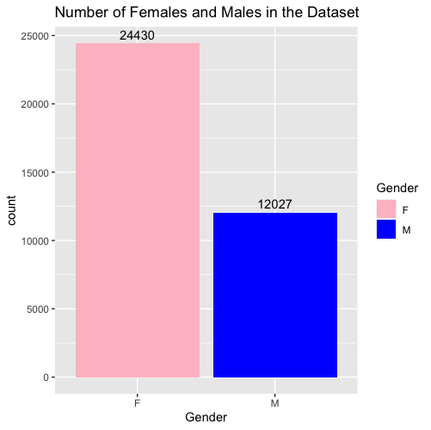
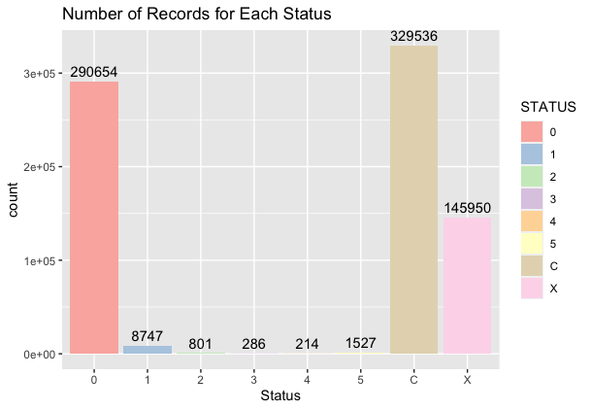
Breakdown of the Dataset by Gender and Records for Each Status Type
Notes:
Gender:
ggplot(IndividualIDS, aes(x=CODE_GENDER, fill=CODE_GENDER)) + geom_bar() + scale_fill_manual("Gender", values = c("F" = "pink", "M" = "blue")) + ggtitle("Number of Females and Males in the Dataset") + geom_text(stat='count', aes(label=..count..))
Applicants by Status:
ggplot(Both, aes(x=STATUS,y = ..count..), stat = "count") + geom_bar(aes(fill= STATUS)) + ggtitle("Number of Records for Each Status") + xlab("Status") + geom_text(aes(label = ..count..), stat = "count", vjust=-0.5) + scale_fill_brewer(palette = "Pastel1")

Slide 11
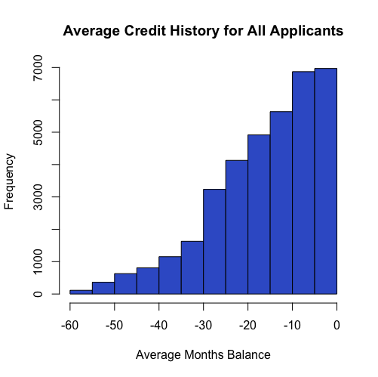
Average credit history of the dataset
Lower negative = longer credit balance history
Most applicants in this dataset do not carry extended balance for too many months
Notes:
hist(AvgCreditHistory$avgMonthsBalance, main = "Average Credit History for All Applicants", xlab = "Average Months Balance", col = "royalblue3")

Slide 12
Exploration into the Variables

Slide 13
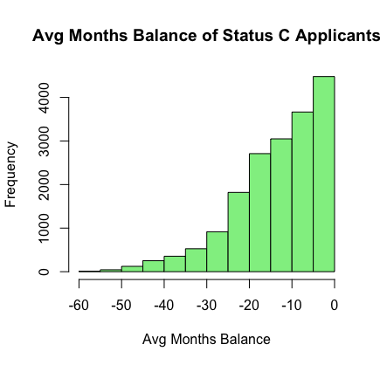
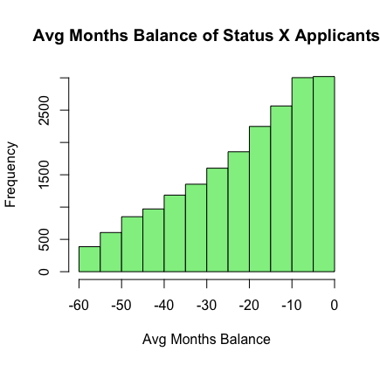
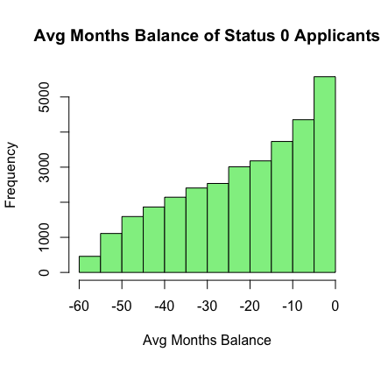
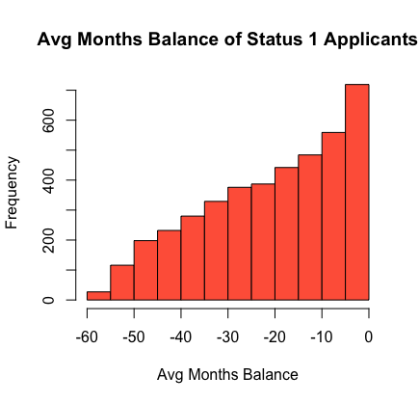
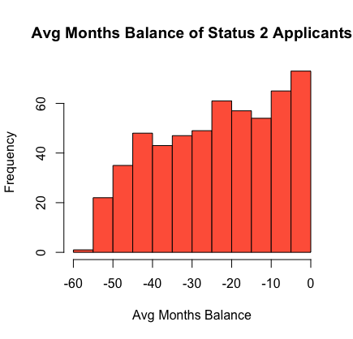
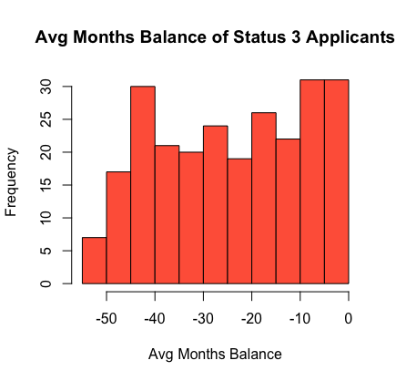
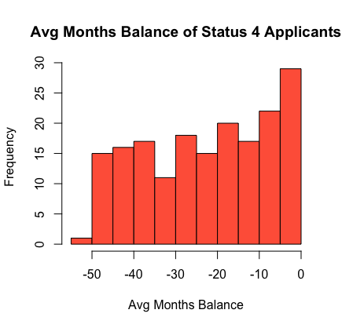
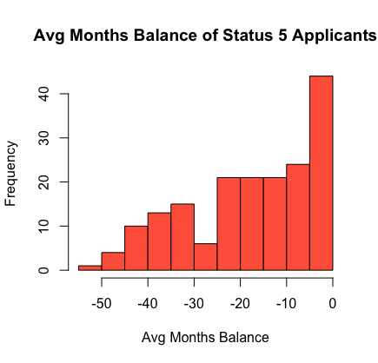
As application status gets worse, average months balance also tends to increase
Notes:
- thought it was interesting to see breakdown of avg months balance for each status group, but also important to note the sample sizes of each group, thought it could be helpful for emphasizing which are "good" vs "bad" candidates if people agree
Status5 <- Both %>%
filter(STATUS == "5")
cr5 <- Status5 %>%
group_by(ID) %>%
select(MONTHS_BALANCE) %>%
summarise(avgMonthsBalance = mean(MONTHS_BALANCE))
cr5
hist(cr5$avgMonthsBalance, main="Avg Months Balance of Status 5 Applicants", xlab="Avg Months Balance", col="tomato")

Slide 14
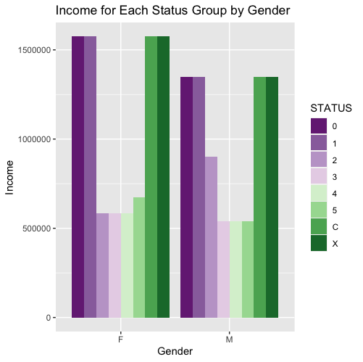
For both males and females, those with better credit status have higher incomes
Data Exploration: Type of Income
Notes:
ggplot(Both, aes(x= CODE_GENDER, y = AMT_INCOME_TOTAL, fill= STATUS)) + geom_bar(stat = "identity", position = "dodge") + ggtitle("Income for Each Status Group by Gender") + xlab("Gender") + ylab("Income") + scale_fill_brewer(palette = "PRGn") + ggtitle("Income for Each Status Group by Gender")

Slide 15
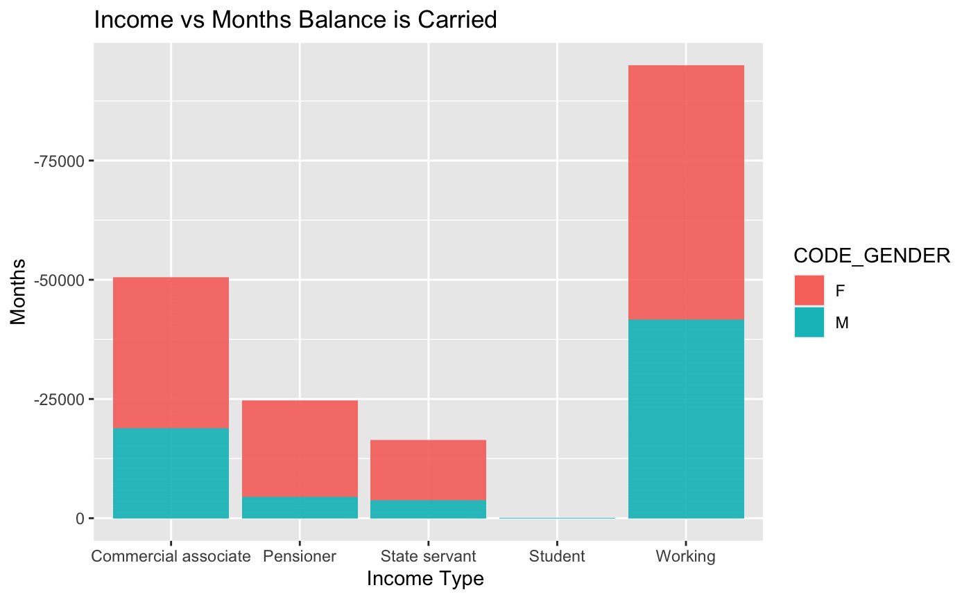
Data Exploration: Type of Income
Those who are working tend to carry their balance over a longer period compared to those who are not ( Pensioner vs student). As seen here students carried the balance the least compared to other groups
Notes:
ar_cr %>%
ggplot(aes(x= NAME_INCOME_TYPE, y = mean(MONTHS_BALANCE, fill = CODE_GENDER)) +
scale_y_reverse() +
geom_bar(stat = "identity") +
xlab("Income Type ") +
ylab("Months") +
ggtitle("Income vs Months Balance is Carried")

Slide 16
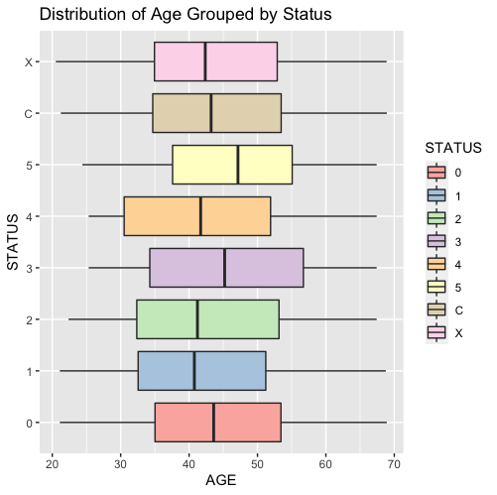
Data Exploration: Age
Age appears to not be super revealing
There are no clear outliers in using an applicant's age to determine if they would pay their loan on time.
Notes:
ggplot(Both, aes(x= CODE_GENDER, y = AMT_INCOME_TOTAL, fill= STATUS)) + geom_bar(stat = "identity", position = "dodge") + ggtitle("Income for Each Status Group by Gender") + xlab("Gender") + ylab("Income") + scale_fill_brewer(palette = "PRGn") + ggtitle("Income for Each Status Group by Gender")

Slide 17
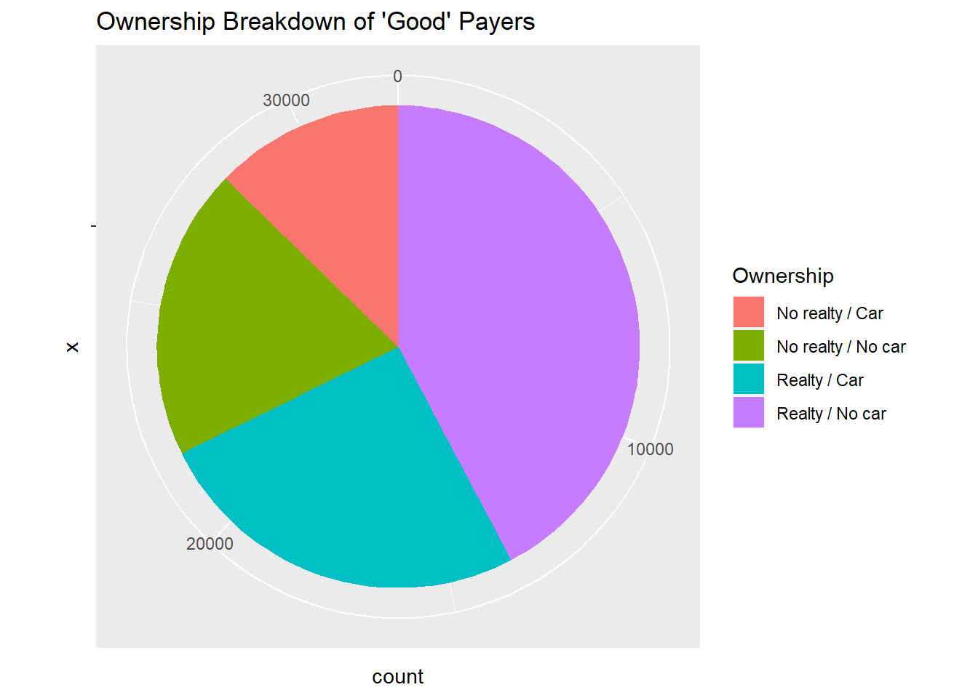
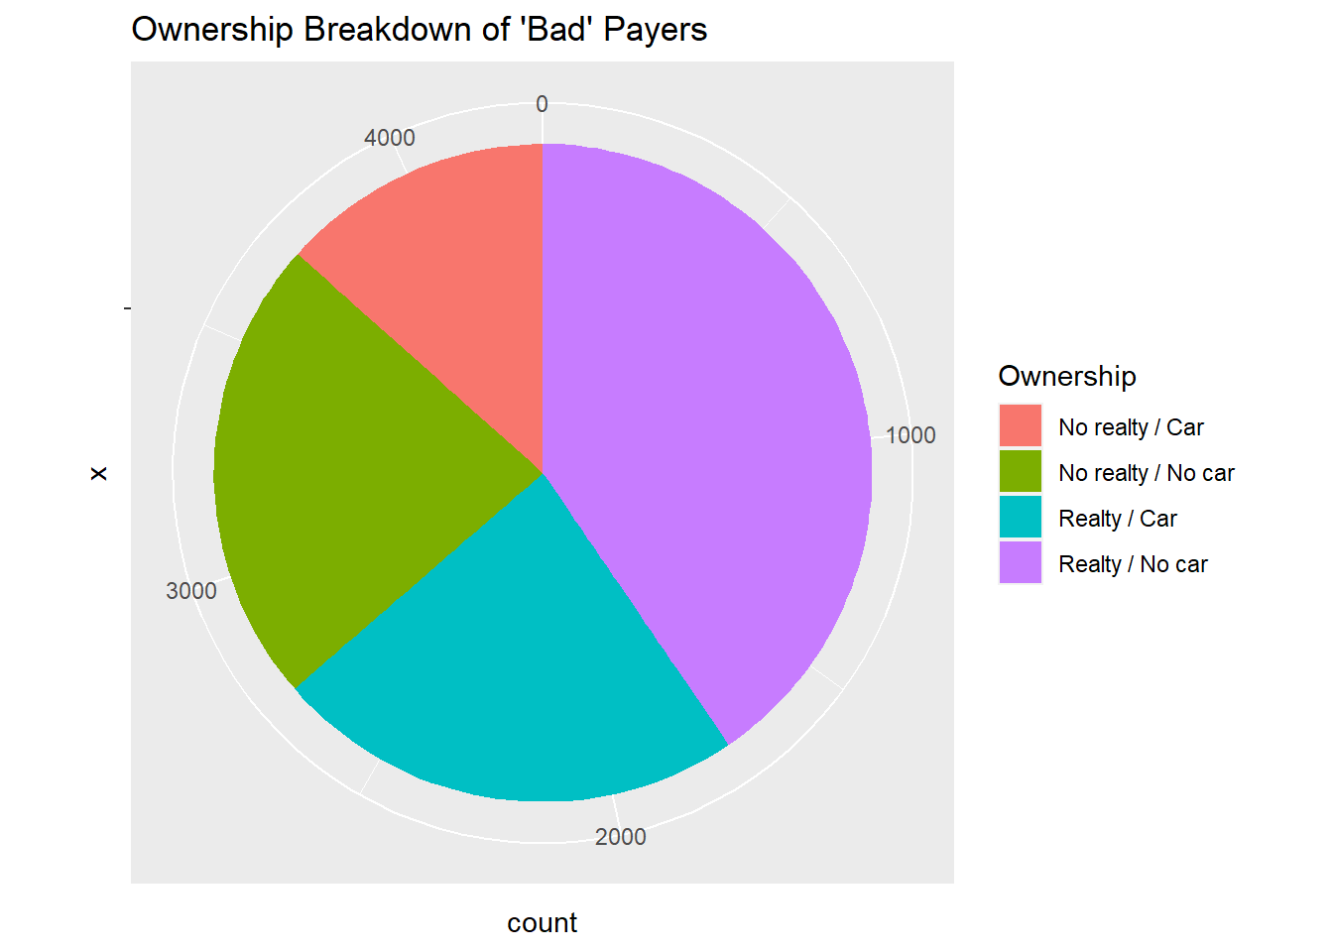
Data Exploration: Ownership
After dividing between good and bad applicants, their ownership profiles are very similar. Though "bad" applicants are slightly more likely to own neither a car or home.
Surprisingly, the largest cohort appears to be people who own real estate, but no car. Such behavior is not prevalent in the US.

Slide 18
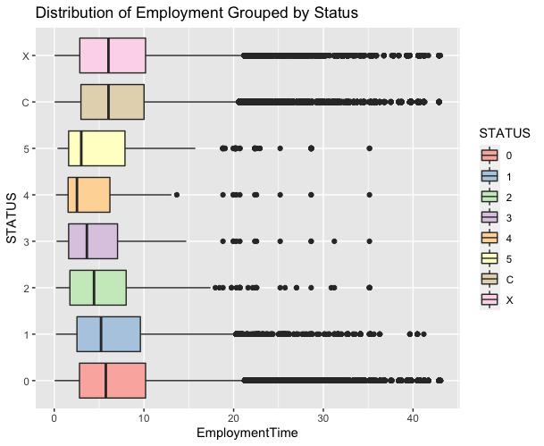
Data Exploration: Employment Time
Applicants with longer employment times tend to have slightly better credit status
Notes:
-
Employed <- Both %>%
filter(EmploymentTime > 0)
ggplot(Employed, aes(group = STATUS, x = STATUS, y = EmploymentTime, fill = STATUS)) + geom_boxplot() + coord_flip() + ggtitle("Distribution of Employment Grouped by Status ") + scale_fill_brewer(palette = "Pastel1")

Slide 19
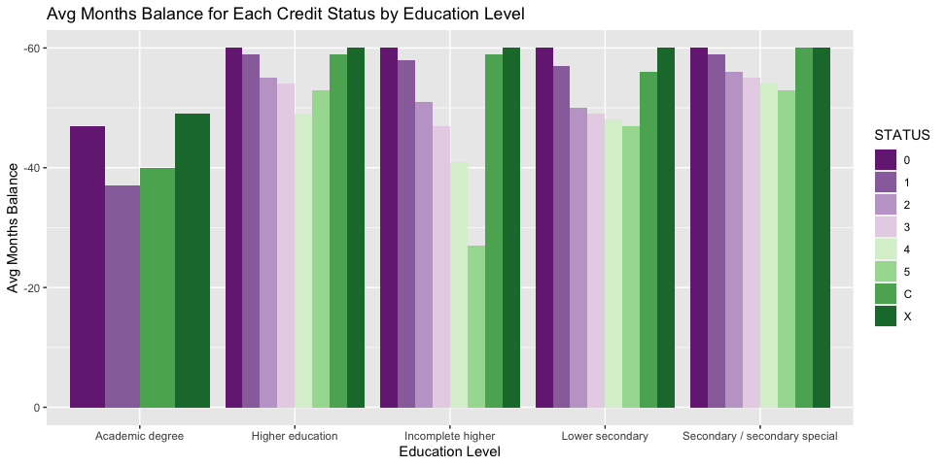
When exploring the education level of applicants, those with more education tend to have better credit status
Notes:
Both %>%
group_by(NAME_INCOME_TYPE) %>%
ggplot() + geom_bar(aes(x= NAME_EDUCATION_TYPE, y= MONTHS_BALANCE, fill= STATUS), stat ="identity", position = "dodge") + scale_y_reverse() + scale_fill_brewer(palette = "PRGn") + ggtitle("Avg Months Balance for Each Credit Status by Education Level") + xlab("Education Level") + ylab("Avg Months Balance")

Slide 20
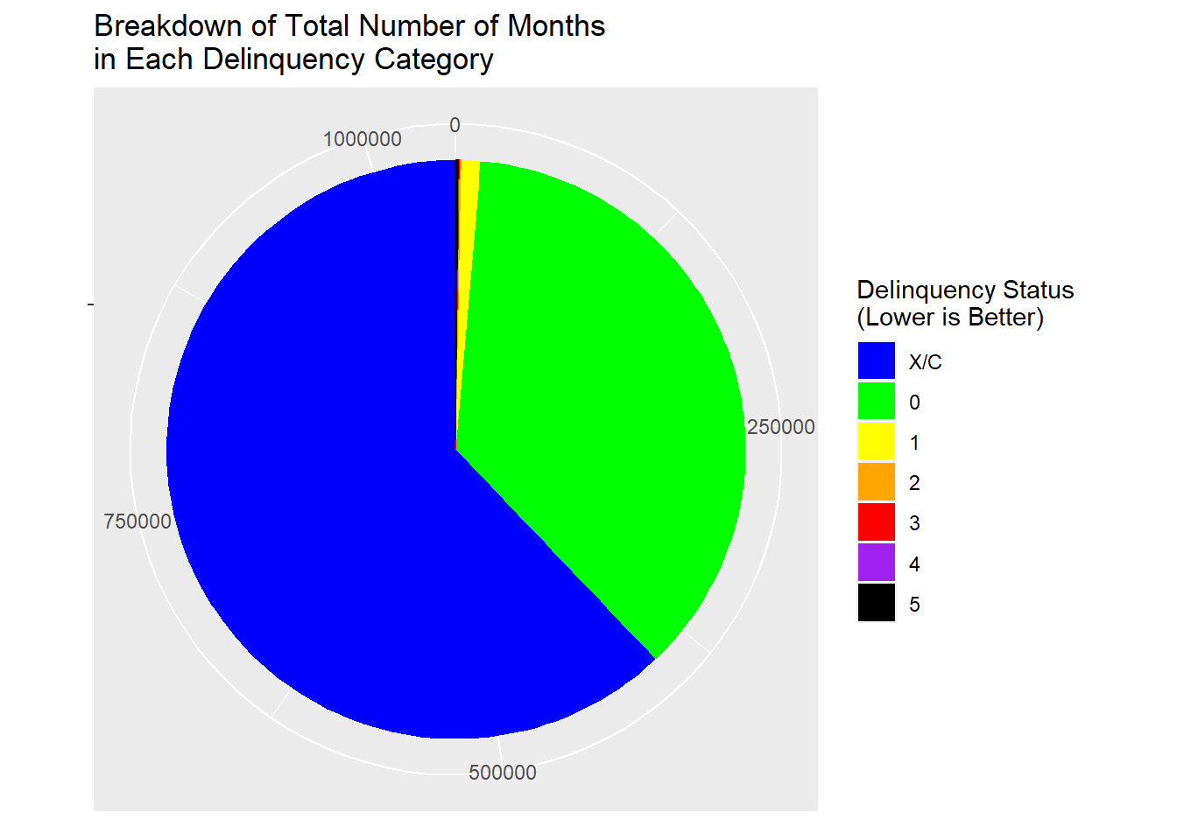
The vast majority of applicants ended up paying their balances off every month

Slide 21
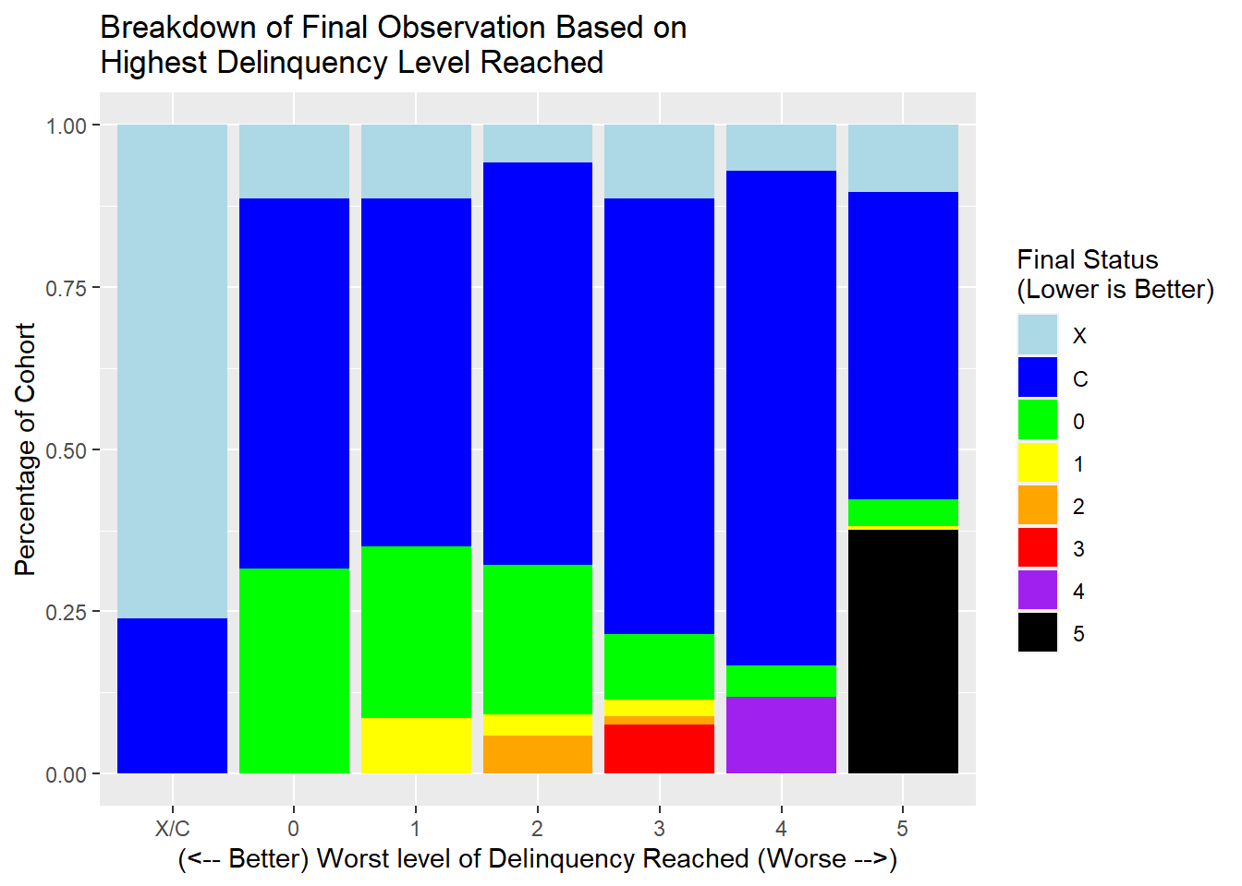
Most people who were delinquent ended up paying off their balance by the end of the observation period
The higher up the delinquency scale a person got, the more binary their behavior was:
They paid off their balance and did not re-enter delinquency
OR
They did not end up paying and hit level 5, where their account was closed
"Point of no return," especially after delinquency level 1

Slide 22
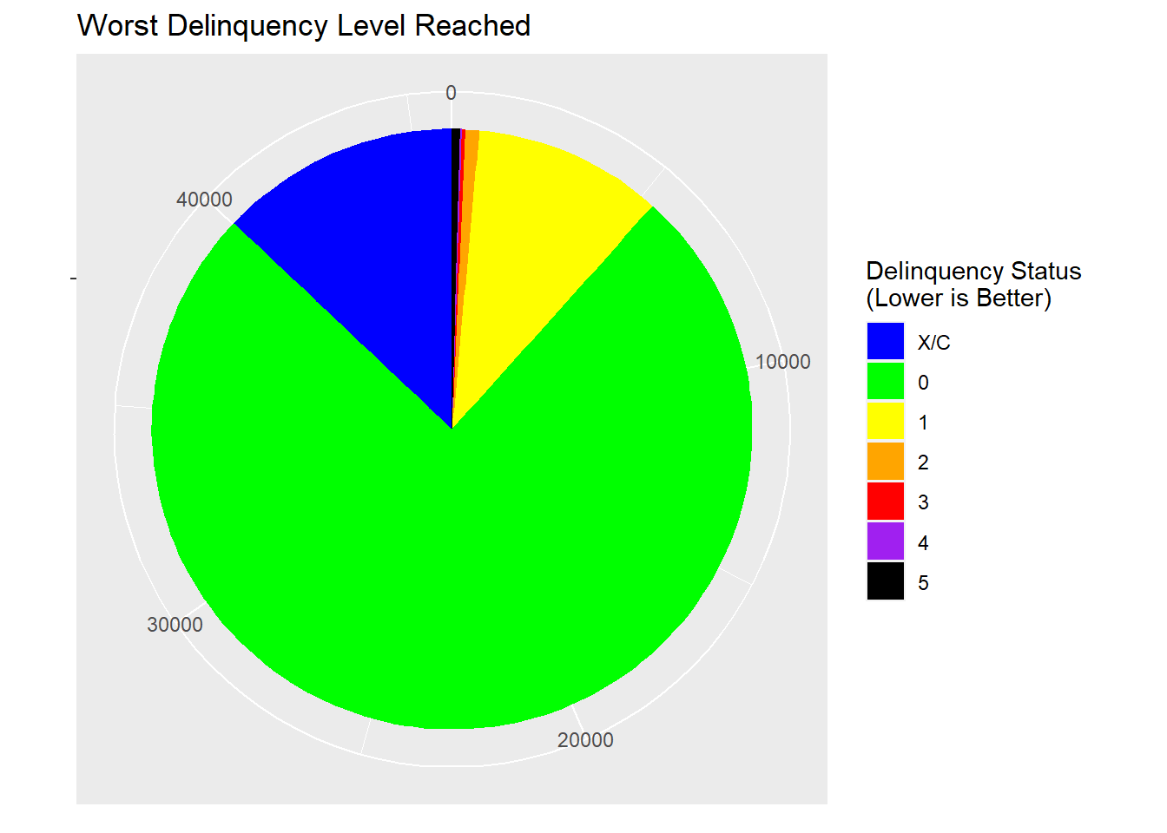
Applicants that reach a max status level beyond 0 will be considered a bad candidate
Worst Delinquency Level | Count of IDs | Percent
X/C | 5,953 | 12.9%
0 | 34,682 | 75.4%
1 | 4,683 | 10.2%
2 | 336 | 0.7%
3 | 88 | 0.2%
4 | 48 | 0.1%
5 | 195 | 0.4%
88.3% of people fall into "good" category
11.7% fall into "bad" category

Slide 23
Take Aways From Exploring Our Data
Based on our data exploration, it seems that those with a higher income would be a better applicant compared to lower income individuals.
Those with a longer employment times tend to pay off their credit than those with lower employment times.
Those with a higher education level have a better status overall, which could be used as a factor to determine if they’re a good applicant

Slide 24
Modeling STATUS
We decided to use more than one model to see if one was more accurate than the other. The following slides explain our models

Slide 25
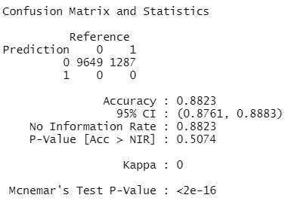
Decision-Tree Model
Using car/home ownership flags, total income, education type, job type, age, gender, and the number family members to determine whether a candidate will be good or bad.
Training set of 25,521 candidates
Test set of 10,936 candidates
Good = 0, Bad = 1
Results: The model guessed all candidates were good, mirroring the no-information rate.
Notes:
prediction_df <- data.frame(gender = as.factor(ar_cr$CODE_GENDER),
income = ar_cr$AMT_INCOME_TOTAL,
age = ar_cr$AGE,
Employment = ar_cr$emp_length,
candidate_state = as.factor(ar_cr$candidate))
training1 <- createDataPartition(y=prediction_df$candidate_state,p=.70,list=FALSE)
train <- prediction_df[training1,]
test <- prediction_df[-training1,]
dim(train)
dim(test)
rpart.plot(model.rpart)

Slide 26
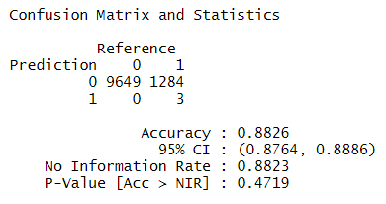
Support-Vector Machine (SVM) Model
Using car/home ownership flags, total income, education type, job type, age, gender, and the number family members to determine whether a candidate will be good or bad.
Training set of 25,521 candidates
Test set of 10,936 candidates
Radial SVM
Good = 0, Bad = 1
Results: Despite all of the factors included in the model, we could not build a predictive model that was statistically better than the no-information rate.

Slide 27
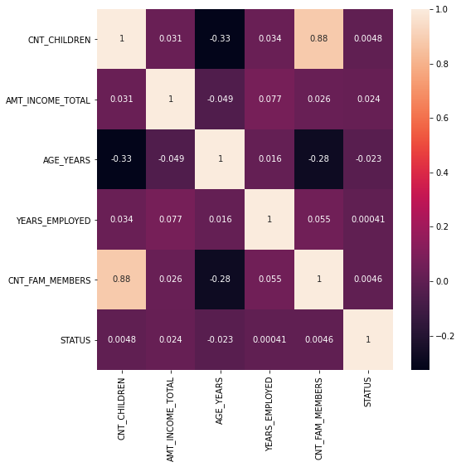
No predictors, by themselves, correlated well with an applicant's STATUS
With the insights we just showcased, we should note that there was no feature that was highly correlated with STATUS.
Partially explains the performance of the models showed previously.
Notes:
# This graph shows that none of our relevant columns/features that are highly correlated with 'Status' (using seaborn package from python)
plt.figure(figsize = (8,8))
sns.heatmap(df.corr(), annot=True)
plt.show()

